Slide 1
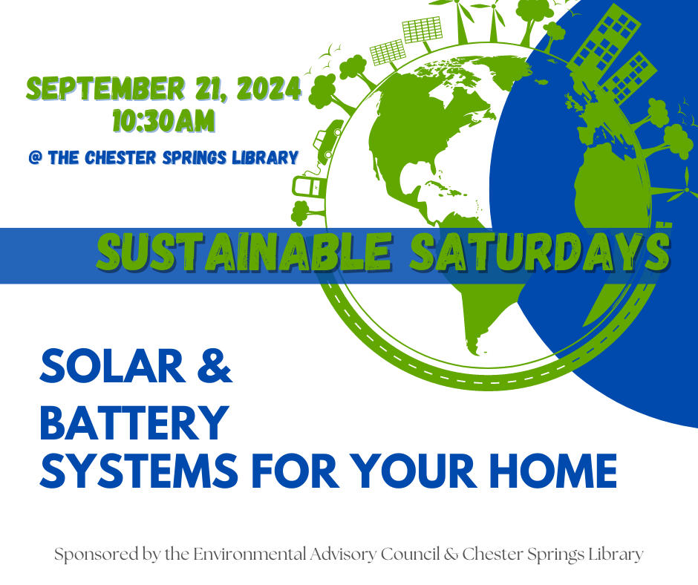


Slide 2
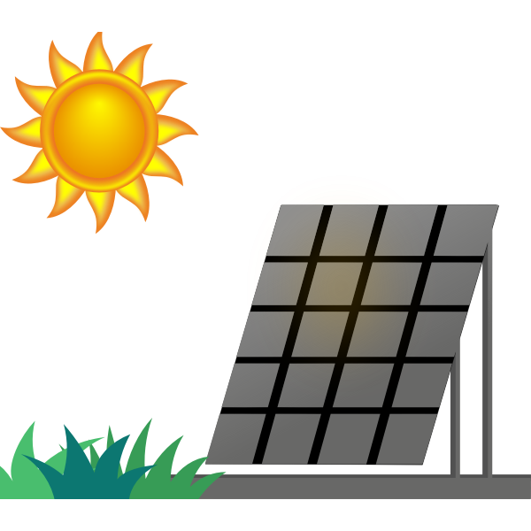





Agenda
Why Solar?
Backup Batteries
Home Viability
Shopping Installers
Installation Process
Payback Period & Incentives

Slide 3
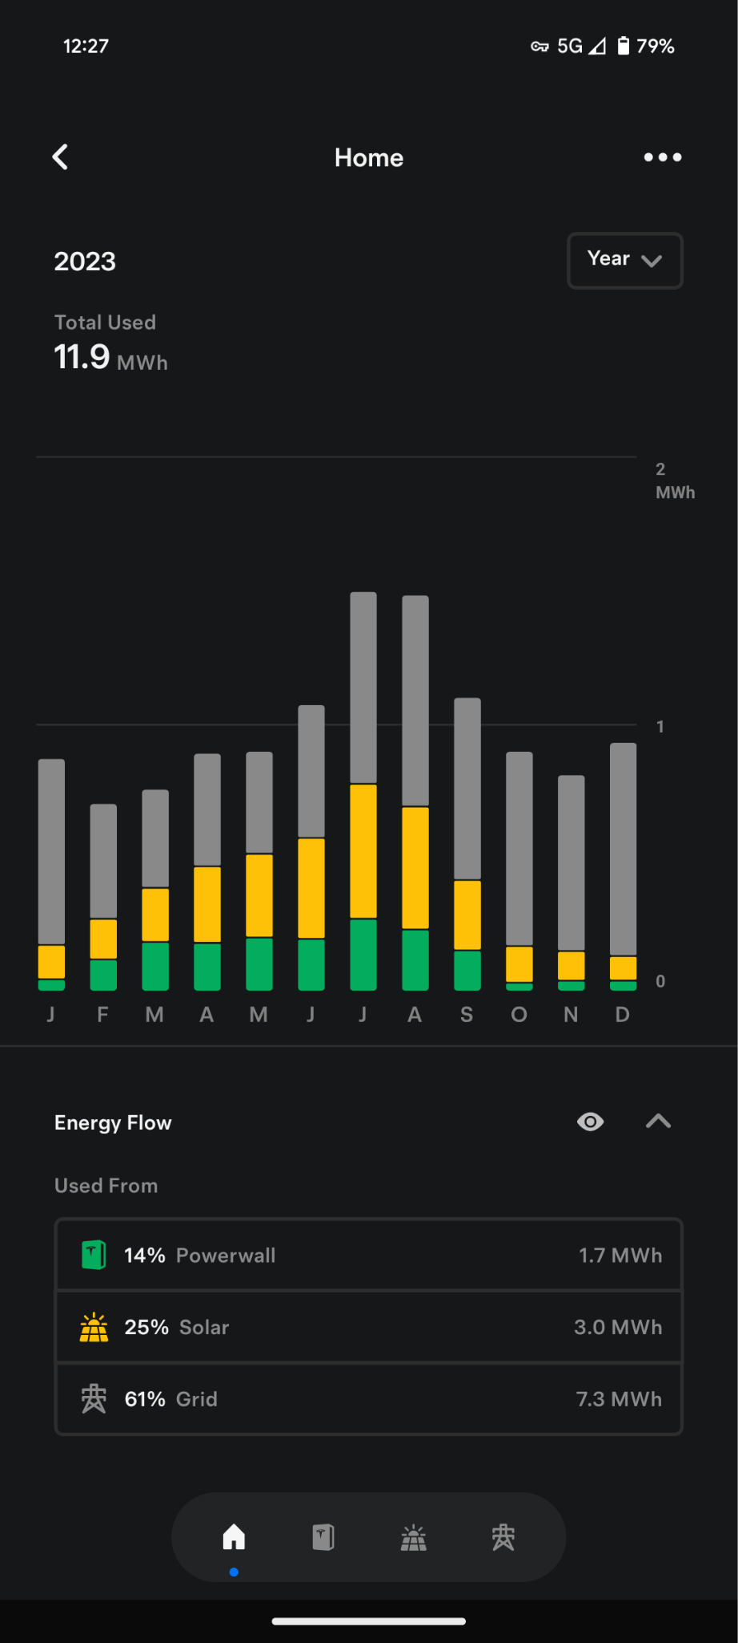
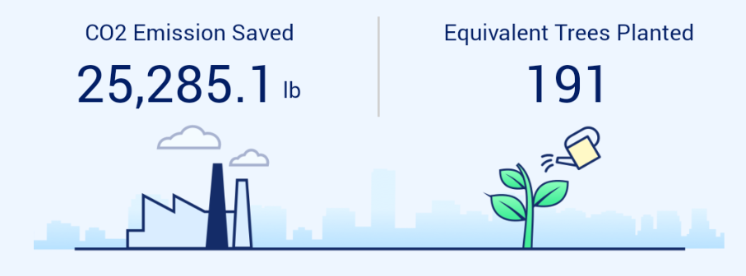
Why Solar?
Save on the electric bill
Environmental benefits
Your savings can vary greatly, depending on your: overall energy usage, heating fuel, and size of solar system.
A system designed to power your entire home could lead to energy bills of $10 or less!
Efficiency will go down during the colder months
  Expect about 30% of your typical summer generation during the winter
Energy independence
With solar panels & a backup battery, you’re no longer reliant on the electric grid.
Keep in mind, this is only an option with a battery - solar alone cannot operate during a power outage.

Slide 4
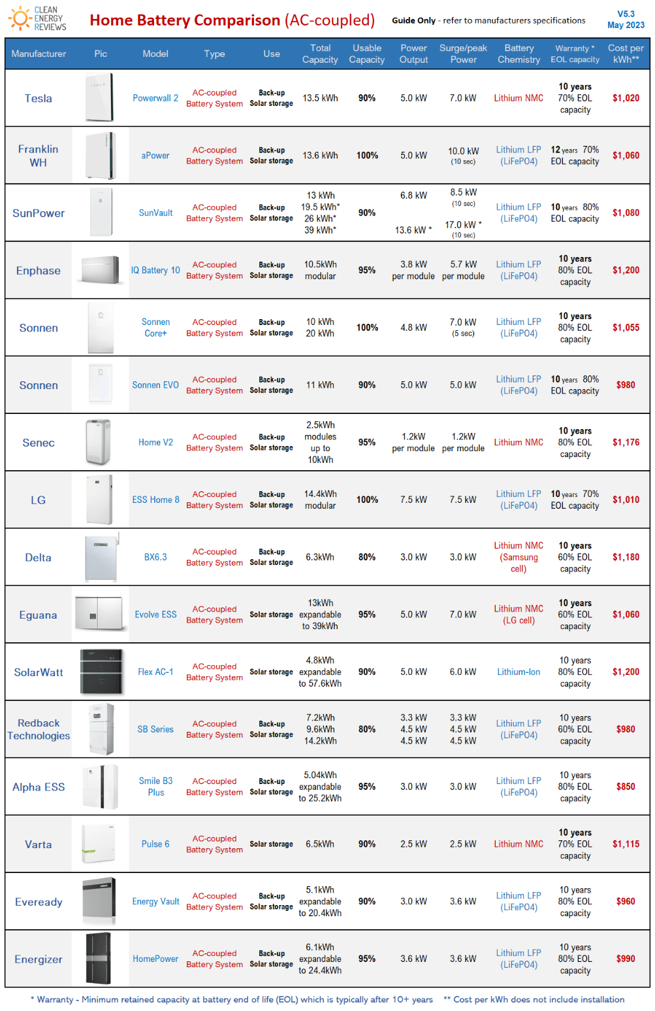
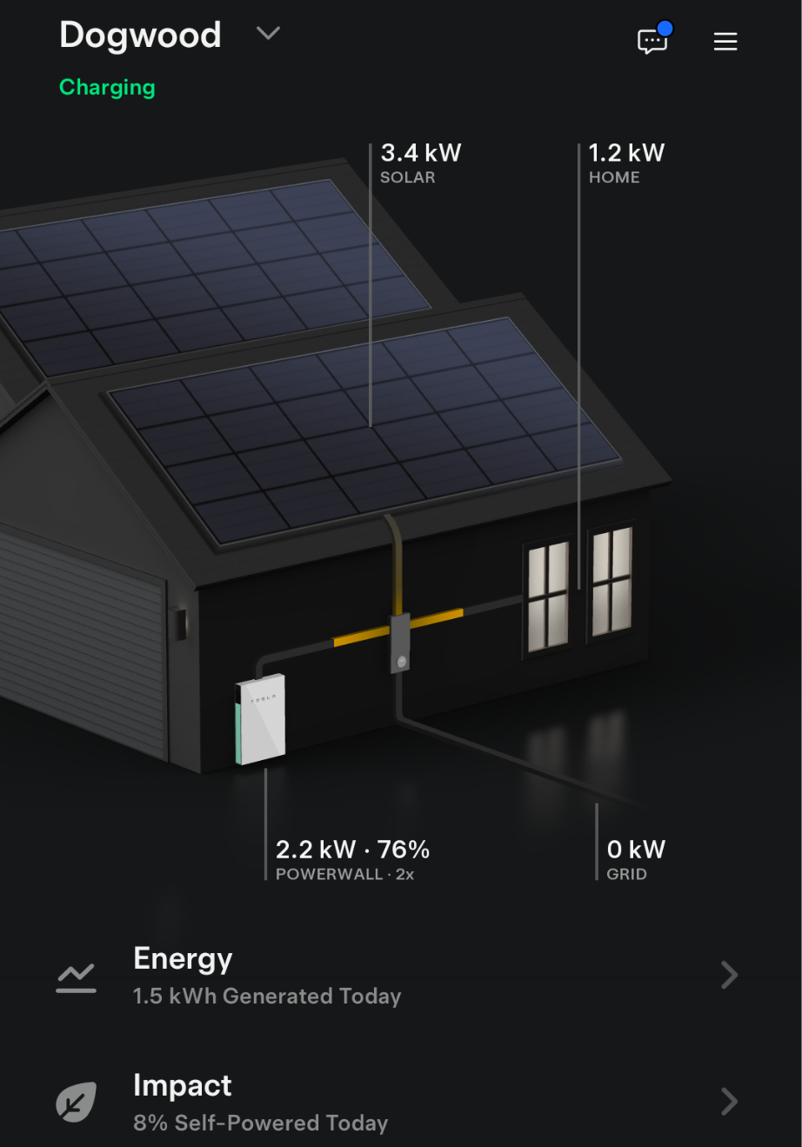
Backup Batteries
Benefits
Backup power during outages
Enables variable rate cost optimization
Backup power during outages
Top Brands
Tesla
SolarEdge
Sonnen
Generac
Enphase

Slide 5
Home Viability
Roof condition and direction
Energy consumption & electrical infrastructure
Roof vs ground mount solar
Are you planning on replacing your roof within 5 years?
South facing roofs are the most efficient generators, but east/west is also perfectly viable
What about solar shingles? (Tesla Solar Roof)
Go check your typical power consumption, per day. For a point of reference:
10kWh system = ~40kWh/day
This is dependent on many variables (time of year, weather, temperature, roof direction & angle)
Check your breaker panel capacity
If your roof doesn’t cut it (subpar direction, can’t handle the weight, atypical design), you can always consider ground mount solar
Same generation potential, typically costs more due to additional equipment required.

Slide 6
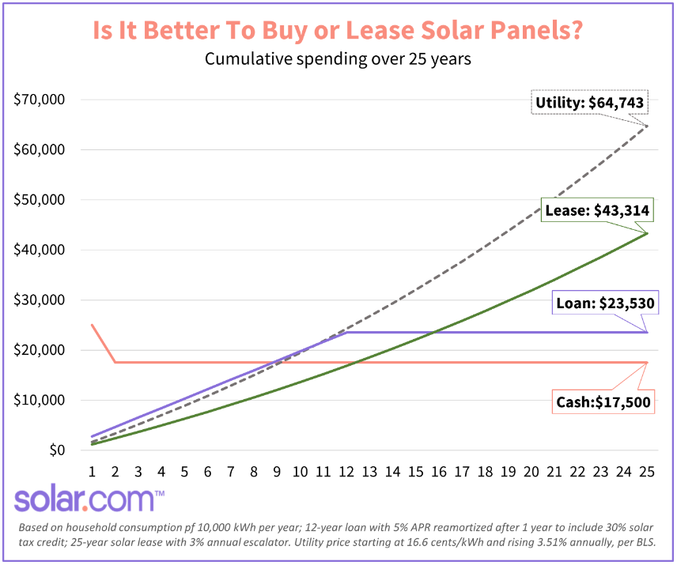
Shopping Installers
What to look & plan for:
Purchasing vs Leasing
Neighbor recommendations
Shop around - at least 3 quotes
Quality of panels & batteries on offer
  Panasonic
  REC
  QCells
  Canadian Solar
  Longi
Google reviews when all else fails
Target around $3 per watt
10kWh install = 10000 Watts -> 3 * 10000 = $30k
Try to target Spring or Fall for the install, if possible - so start the process in Summer or Winter

Slide 7

Installation Process
~ 30 days
1-3 months
1-2 months
Design
Permitting
Installation
PTO
Each company will visit to assess your home for solar viability
Quote should include generation estimates, itemized costs, projected sun exposure on roof
Your installer should cover all permitting tasks
This can often be the lengthiest process (1-3 months)
Could take anywhere from 3-5 days, depending on size & complexity of system
If equipment is not in stock, the wait could be a month+
Once the system is installed, you cannot operate it yet.
PTO, or Permission to Operate, must be granted by your electric distributor (PECO).
PECO will often need to install a net meter on your home as well.

Slide 8
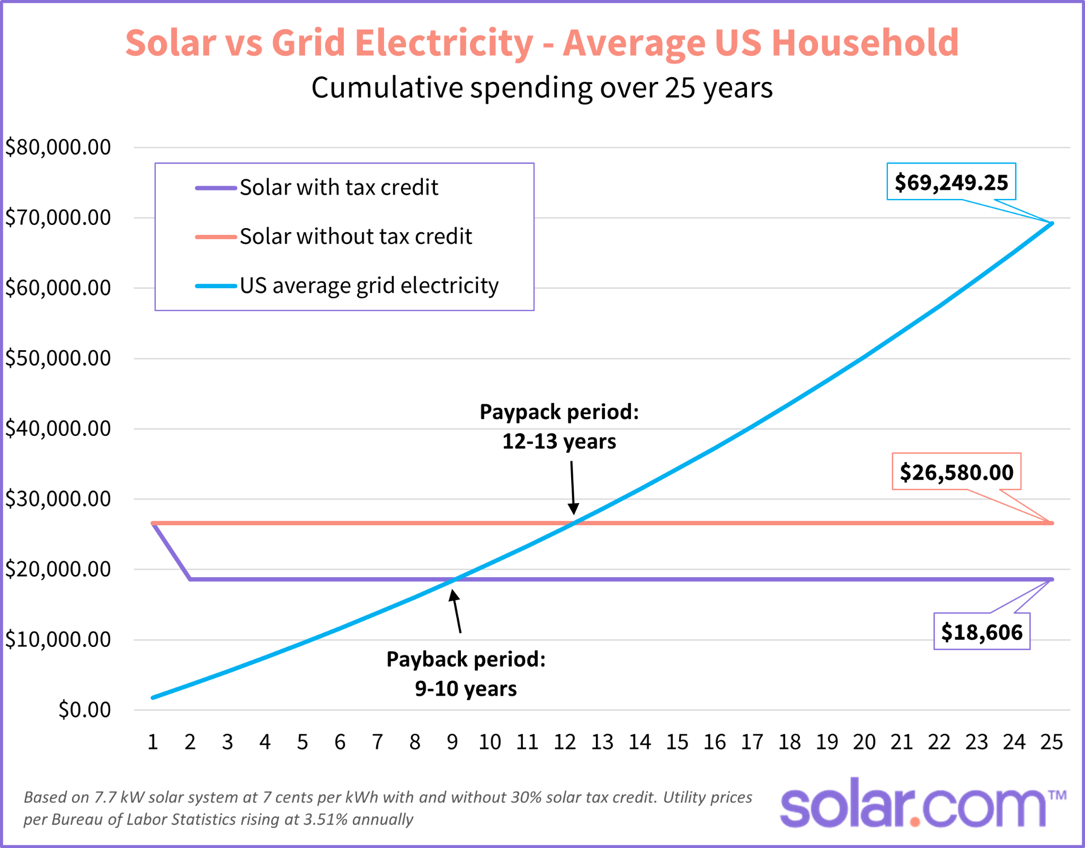
Payback Period & Incentives
Solar-only
Variable rate electric
Incentives
‘Payback period’ refers to the amount of time it takes to recoup your investment
Typically 7-10 years
Leveraging backup batteries, you can selectively choose to use battery storage during the day, and pull from the grid at night - when electricity is generally cheaper
Requires diligence, but can be quite lucrative
https://www.papowerswitch.com/
Federal tax incentive provided by the IRA (Inflation Reduction Act) covers 30% of the entire solar & battery installation, with no cap (assuming 30% does not exceed your tax liability)

Slide 9
Recap & Q/A
For a typical house in West Pikeland, you’re looking at ~22k total for a solar installation.
Lifecycle of the panels (25 years), you can expect to save ~45k on electricity.
Any questions?
~35k if you include 2 backup batteries.
Once everything is complete, you’ll essentially never be without power again.
The process can take up to 6 months from start to finish.

