Slide 1
West Pikeland Township Summary of Carbon Emissions
For the Calendar Year 2019
Prepared by: Donna D. Switzer, CHMM, CPEA, CSR-P
March 2020, Updated Jan 2021
www.beyondcompliance.consulting

Slide 2
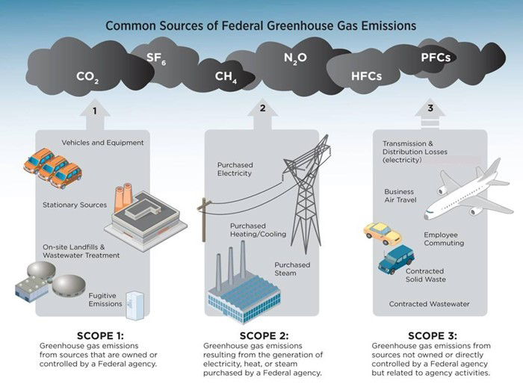
Although this pictogram refers to Federal agency, it is applicable to Municipal government as well

Slide 3
Summary Data, Calendar Year 2019
Total GHG Emissions 302 Tons CO₂e

Slide 4
More Data Detail (2019)
8,540 gallons of gasoline purchased for police fleet
120,357 kilowatt hours purchased from PECO (FYI - my house used ~1,600 kwh in Dec)
Township Building
Pine Creek
Palmer House
Traffic Light
272 tons of waste disposed (single stream recycled about the same amount)
23,450 miles traveled by employees (commuting and for business)
5,000 gallons gasoline purchased for landscaping/snow removal (assumed)
This is the weakest link

Slide 5
Opportunities
Mobile sources are by far the biggest source of carbon emissions for the Township
Emissions from stationary sources can be reduced by converting from No. 2 fuel oil to natural gas to heat the buildings
Carbon savings from recycling waste vs landfilling waste
Emissions from purchased electricity can be reduced by utilizing non-fossil fuel renewable energy sources
Purchase energy from renewal sources as an interim

Slide 6
About the Data
Calculations, emissions factors, and global warming potential are based on the World Resources Institute Greenhouse Gas Protocol
Assumptions were made about public works fuel usage, due to lack of data
Electricity Purchased emissions were derived from location based calculations (eGrid subregion RFC East)
Electricity and fuel use were obtained from receipts maintained in the Township business records
Employee commute and business travel information was obtained through Township employee interview
Emissions are listed in CO₂ equivalent (CO₂e), the universal unit of measurement to indicate the global warming potential (GWP) of each greenhouse gas, expressed in terms of the GWP of one unit of carbon dioxide

